Slide 1
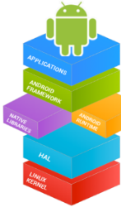

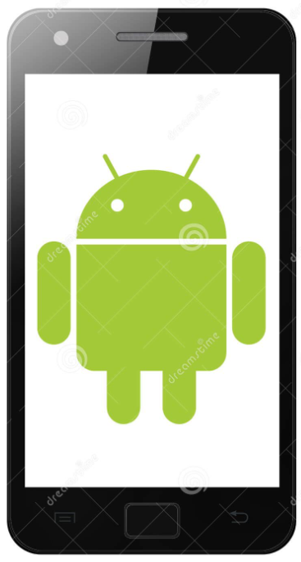

Mobile Application Development (COS7025-B) Designing Mobile Apps using Android Mobile Application Testing
Karim Hammoud Sadik
Lecture #10
Android Studio

Slide 2
Content
Understood the usefulness and purpose of mobile application testing
Discussed the types of mobile application testing
Applied Usability testing metrics on an example application

Slide 3
Discussion: Why (mobile app) testing is important?
“Mobile users are fussy and impatient. They determine within seconds whether they like a mobile site or app. If it is too complicated or too slow, they will move on and possibly post a negative review in the app store.” Rameen Taheri , Adobe Systems
Forbes contributor Tom Taulli notes that “in today’s landscape, it’s not just about having a “cool” application; users are more likely to abandon a program if it has functionality problems, no matter how promising it seems.”
“About half of the poor reviews on app stores are based on issues like crashes, network performance and battery drain,” Jay Srinivasan, application development expert.
“The harsh reality is that the diversity and choice that make mobile products and services so attractive can just as easily trip up companies if they do not carefully apply quality assurance and testing to applications right from the early stages of deployment.” Fernando Alvarez, Capgemini

Slide 4
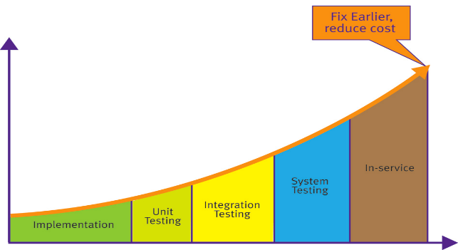
The cost of defects
The later a defect is found in the product development, the more costly it is to fix . This is a concept first established in 1975 with the publication of Frederick Brooks’ “Mythical Man Month” and proven many times since through various studies.
(Image source: embeddedinsights)

Slide 5
Types of Mobile Application Testing
Usability Testing
Assessing how easy user interfaces are to use.
Carried out by testers in conjunction with participants (real users)
Unit Testing
Testing smallest testable parts of an application, units.
Carried out by developers.
Functionality Testing
Testing against the business requirement.
Carried out by functional testers/developers.
System/Integration Testing
Verifying that all related systems maintain data integrity and can operate in coordination with other systems in the same environment.
Load (Performance) testing
To discover what causes your specific performance problems (primarily involves four pieces of hardware, CPU, GPU, memory, and battery; they all have constraints)

Slide 6
Types of Mobile Application Testing
Usability Testing
Usability is a quality attribute that assesses how easy user interfaces are to use.
The word "usability" also refers to methods for improving ease-of-use during the design process
(Nielsen, J. (1993) Usability Engineering. Academic Press. Chapter 2.2, p. 26. )
Jakob Nielsen is a well-known name in usability testing– his website: http://www.nngroup.com/people/jakob-nielsen/ (Bookmark this!)

Slide 7
Types of Mobile Application Testing
[Neilson’s] Five Attributes of Usability
Usability testing is combination of the following:
Intuitive Design: the user should put almost zero efforts to understand the architecture and navigation of the system
Ease of learning – how fast a new user to the system can do basic tasks
Efficiency of use – how fast an experienced user can complete tasks
Memorability – the user should be remembering the system usage to use the system effectively in the future
Error frequency and severity – it deals with the frequency of user errors while using the system and they correct those errors.

Slide 8
Types of Mobile Application Testing
Usability Testing Steps [Nielsen, 1993]
Define scope & purpose of testing
Decide on scenarios for testing
Decide on test/usability metrics
Recruit Participants
Run Test

Slide 9
Usability Testing Steps [Nielsen, 1993]
Steps 1. Defining Scope and Purpose
Scope: Indicate what you are testing? Specify how much of the app the test will cover (e.g. the prototype as of a specific date; the navigation; navigation and content).
Purpose: Identify the concerns, questions, and goals for this test.
These can be quite broad; for example:
"Can users navigate to important information from the prototype's home page?"
“How usable is certain version of the system?”
They can be quite specific; for example,
"Will users easily find the search box in its present location?" Your concerns should drive the scenarios you choose for the usability test.

Slide 10
Usability Testing Steps [Nielsen, 1993]
Step 2. Decide on Scenarios for Testing
Two Types of scenarios are generally possible.
First, Goal- or Task-Based Scenarios state only what the user wants to do. Do not include any information on how the user would complete the scenario.
An Example: For the coursework mobile app, set a task for a busy person (admin) to do three different things, for example, adding a new record, remove user, and remove a record.

Slide 11
Usability Testing Steps [Nielsen, 1993]
Scenarios for Testing
Second, Full scale Task Scenarios include the steps to accomplish the task. A full-scale scenario can report all the steps that a specific user currently takes to accomplish the task
An Example: For the coursework mobile app, a full-scale scenario may include steps such as: (1) Login using your account (2) click on “Add a record” or the “+” symbol from the Toolbar (3) If you are on a tablet device…do ...this ...otherwise..do ..this.. (4)...

Slide 12
Usability Testing Steps [Nielsen, 1993]
Step 3. Decide on Usability Metrics
Think of yourself as a developer of an app. How do you prove and document that it is usable in a scenario/task or for achieving some goal(s)?
You can ask questions to your participants!
Questionaries are a standard techniques for usability evaluation. Few widely used options are available that are well-tried and tested.
See the table in the next slide

Slide 13
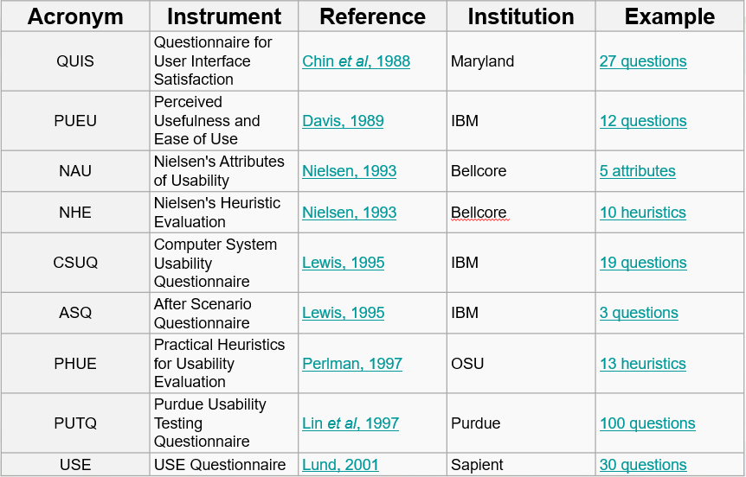
Usability Metrics
Hosted by University of Geneva @ http://edutechwiki.unige.ch/en/Usability_and_user_experience_surveys

Slide 14
Usability Testing – Industry
The demands of evaluating usability of systems within an industrial context which means that no cost-effective or practical efforts to perform analysis and selection of suitable metrics.
All that is needed as a general indication of the overall level of usability of a system compared to its competitors or its predecessors
Equally, when selecting metrics, it is often required to have measures which do not require vast effort and expense to collect and analyse data.
“A pragmatic approach”
Brooke, J. (1996). SUS-A quick and dirty usability scale. Usability evaluation in industry, 189(194), 4-7.

Slide 15
Industry – Few examples
Guerrilla Testing with Usability Café –
https://www.youtube.com/watch?v=0YL0xoSmyZI
Usability by Jackob Neilsen
https://www.youtube.com/watch?v=r0A6IW2TFFI
Reflect and Discuss
You just watched a youtube video of a usability testing carried out in Guerilla format.
Reflect on:
Top 3 ideas that you liked about this way of testing?
Were there any aspect which you were not sure about?
Can you see yourself using such testing technique?

Slide 16

Usability Testing – Industry
The SUS (System Usability Scale) is a 10-item questionnaire with 5 response options.
I think that I would like to use this system frequently.
I found the system unnecessarily complex.
I thought the system was easy to use.
I think that I would need the support of a technical person to be able to use this system.
I found the various functions in this system were well integrated.
I thought there was too much inconsistency in this system.
I would imagine that most people would learn to use this system very quickly.
I found the system very cumbersome to use.
I felt very confident using the system.
I needed to learn a lot of things before I could get going with this system.
The SUS uses the following response format:

Slide 17
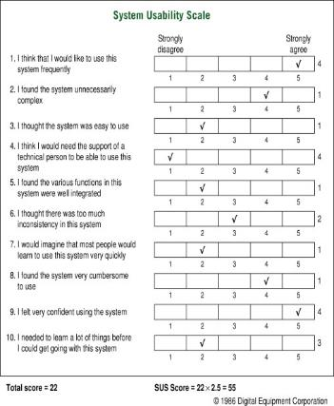
System Usability Scale - SUS
Scoring SUS
To calculate the SUS score, first sum the score contributions from each item. Each item's score contribution will range from 0 to 4.
1. For items 1,3,5,7,and 9 the score contribution is the scale position minus 1.
2. For items 2,4,6,8 and 10, the contribution is 5 minus the scale position.
3. Multiply the sum of the scores by 2.5 to obtain the overall value of SUS.
SUS scores have a range of 0 to 100.

Slide 18
Usability Testing Steps
Step 4. Recruitment of Participants
Who?
It is vital to recruit participants who are similar to your app users for your usability testing.
Use of Roles: stereotyping the user types. For example, based on demography, age group? Gender?
How many?
Nielson: http://www.nngroup.com/articles/how-many-test-users/
Usability Tests: 5 users lets you find almost as many usability problems as you'd find using many more test participants. [advisory]

Slide 19
Usability Testing Steps
Step 5. Run Test. Have a protocol – for uniformity
An example:
The facilitator will welcome the participant and explain the test session, ask the participant to sign the release form, and ask any pre-test or demographic questions.
The facilitator explains thinking aloud and asks if the participant has any additional questions. The facilitator explains where to start.
The participant reads the task scenario aloud and begins working on the scenario while they think aloud.

Slide 20
Usability Testing Steps
Step 5. Run Test. Have a protocol – for uniformity
The note-takers take notes of the participant’s behaviors, comments, errors and completion (success or failure) on each task.
The session continues until all task scenarios are completed or time agreed has passed.
The facilitator either asks the end-of session subjective questions or sends them to an online survey, thanks the participant, gives the participant the agreed-on incentive, and escorts them from the testing environment.

Slide 21
Types of Testing
Usability Testing
Functionality Testing
Unit Testing
System/Integration Testing

Slide 22
Types of Testing
Functionality Testing
Testing an application against the business requirement is called “functional testing”. In Simple words testing all the specifications given by the client is functional testing.
There are generally little differences between how functional testing is done for traditional software and the mobile applications.
Hence, same methodologies can be applied. One example is provided in next few slides

Slide 23
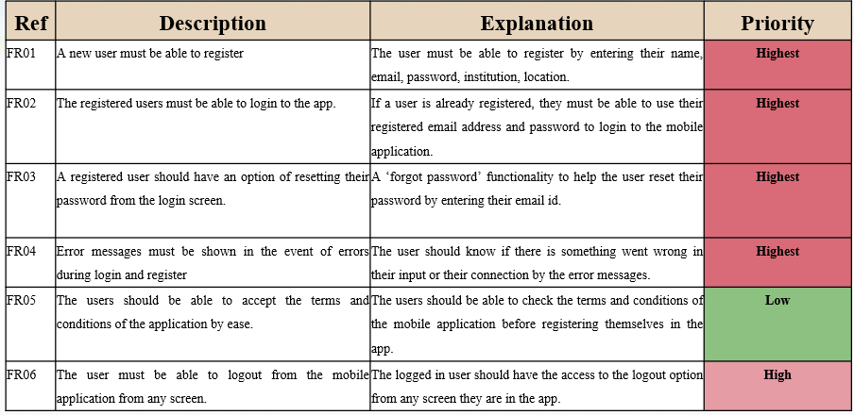
Functional Requirements – An example

Slide 24
Functional Requirements Testing – Manual Testing using scenarios/criteria
Test Reference | FTS02
Tested Requirement | FR02
Test Content | Checks if the user is able to login
Input | The user have to complete the form in the login screen.
Pass Criteria | Once the user is successfully logged in using the registered login credentials, the user will be directed to the home page.
Result | PASS
Test Reference | FTS01
Tested Requirement | FR01
Test Content | Checks if the user is able to register
Input | The user have to complete the form in the registration screen.
Pass Criteria | Once the user is successfully registered, the user will be directed to the home page.
Result | PASS

Slide 25
Types of Testing
Unit Testing
Unit testing is a software development process in which the smallest testable parts of an application, called units, are individually and independently inspected for proper operation.
Unit testing is often automated, but it can also be done manually.
Who does Unit Testing? : Developers
Benefits:
Issues are found at early stage.
Reduction in cost of bug fixes and overall development.
Unit testing helps in simplifying the debugging process. If suppose a test fails then only latest changes made in code needs to be debugged.

Slide 26
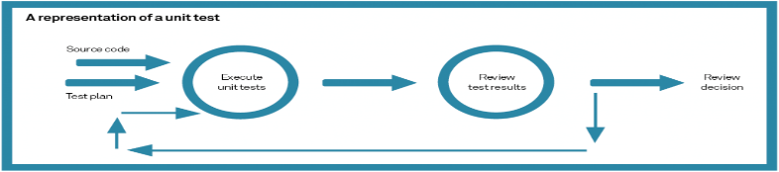
Types of Testing
Unit Testing
Unit tests are automated tests written to ensure that a particular piece of code, often a method or a class, behaves as expected. In Android, unit tests can be run locally on the Java Virtual Machine (JVM) without the need for an emulator or physical device, making them fast and efficient.
Android unit tests are typically written using JUnit, a popular testing framework for Java. Mockito, a mocking framework, is often used in conjunction with JUnit to create mock objects and define their behaviour. These tools together provide a robust environment for writing and running unit tests.

Slide 27
Types of Testing
To see how to preform testing in Android Studio click on the link below
To see how Android testing with Espresso Framework can be done, click on the link below
To see how to do Mobile App performance testing using APPTIM
https://developer.android.com/studio/test/test-in-android-studio
Android user interface testing with Espresso - Tutorial (vogella.com)
https://www.youtube.com/watch?v=11KmP8W5mQc

Slide 28
Any Questions?

